Slide 1


OFFEROR’S TOOLBOX
US Probation Office
and
US Pretrial Services Office
Eastern District of California
Fiscal Year 2020 Solicitations

Slide 2

navigation
To navigate through this presentation:
  Use the Adobe tools to advance to the next or previous page.
You may go to the Table of Contents any time, by clicking on the seal in the upper left corner
In the Table of Contents, click on a page number to go to a specific section.

Slide 3
TABLE OF CONTENTS
Welcome & Introduction 4
RFP Goals 12
RFP Overview 14
FY-2020 Solicitations 18
Section A 20
Section B 22
Section C 30
Section D through I 36
Section J 38
Section K 41
Section L 44
Section M 51
Submitting your proposal 59
Award 65
Summary 67
Questions & Thank You 73

Slide 4
WELCOME & INTRODUCTION
Fiscal Year 2020 Solicitations

Slide 5
PURPOSE
The purpose of this toolbox is to:
  Clarify the Request for Proposal (RFP) and process
  Answer common questions
  Help offerors submit proposals which are:
    In order
    Complete, and
    Contain all the required documentation
IMPORTANT: This toolbox does not replace or supersede the requirements prescribed in Section L of the RFP

Slide 6
Commonly Used
ACRONYMS AND TERMS
AO Administrative Office of the United
States Courts.
BPA Blanket Purchase Agreement
CO Contracting Officer
Defendant Adult supervised by USPSO
Offender Adult supervised by USPO
PC Project Code
RFP Request for Proposal
Solicitation # The number assigned to each solicitation
(Note: This number becomes the BPA # after award)
USPO United States Probation Officer
USPSO United States Pretrial Services Officer

Slide 7
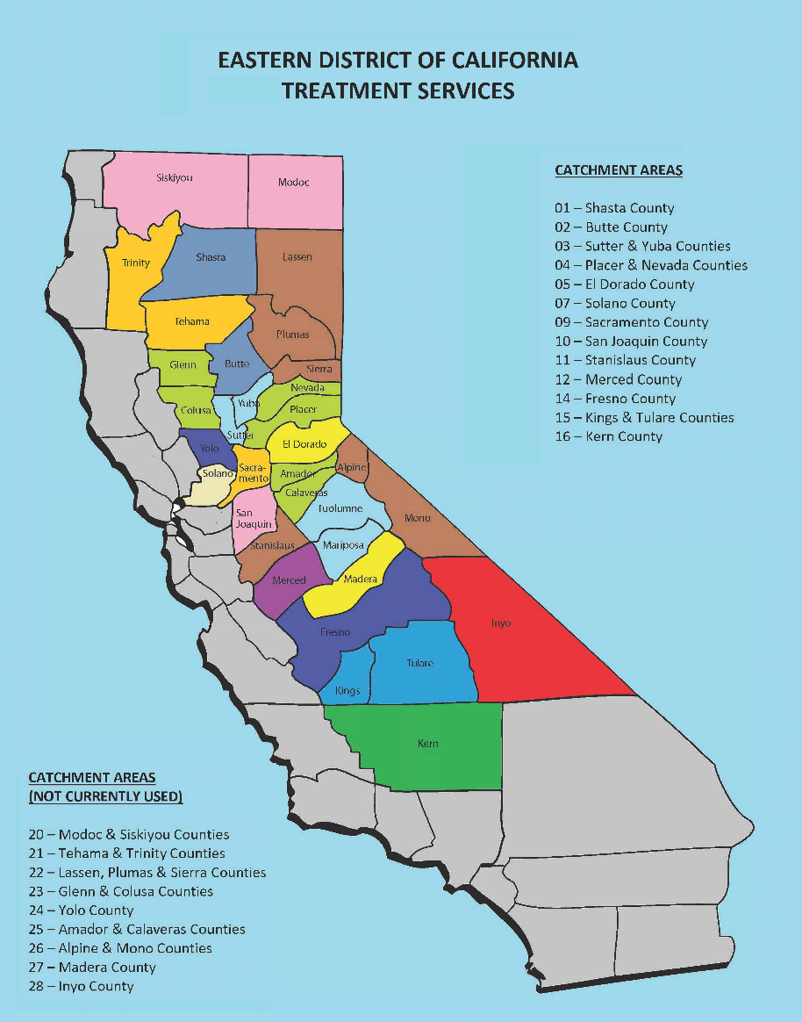
DISTRICT BOUNDARIES &
CATCHMENT AREAS
California Eastern District (CAED) runs from the Oregon boarder south to Kern County, along the eastern side of California.
Each RFP will have it’s own catchment area, which may be:
  A city or cities
  A county or counties
  A Geographic area
  The entire district

Slide 8
Types of supervision
US Pretrial Services Office:
  US Pretrial supervises offenders during period of arrest through sentencing. Some are convicted; some are not yet convicted.
US Probation Office:
  US Probation supervises offenders once they have been sentenced. Some are on Probation in lieu of incarceration. Most on supervised release have been previously incarcerated. Offenders are typically supervised for 2 to 3 years.

Slide 9
WHO IS THE CLIENT?
Who is the Client?
  US Probation Office/US Pretrial Services Office
  US District or Magistrate Court
  The Community
  The Defendant/Offender
Please keep in mind that we – the USPO & USPSO – are the primary clients, not the defendant or offender.

Slide 10
Teamwork
Teamwork between the Treatment Provider and US Probation Office/US Pretrial Services Office is critical for the success of defendants and offenders.
This teamwork is based on:
  Three-way staffing between the Treatment Provider, USPO/USPSO, and the defendant/offender.
  Accurate and timely preparation of:
    Physical and Psychological Evaluations and Reports
    Monthly Treatment Reports
    Quarterly Treatment Plans
  Prompt notification to the USPO/USPSO of behavior in violation of the defendant’s/offender’s terms of release.

Slide 11
Types of referrals
Overview of Types of Referrals:
  Types of offenses committed by defendants/offenders include: Bank robbery, drug distribution, credit card fraud, mail theft, bank fraud, internet offenses, sex-related offenses, and anything that occurs in a National Park, military base, or on an airplane or across state lines, etc.
  Typical disorders defendants/offenders suffer are: Those found on DSM Axis I and II
  Treatment needs include – Improve mental health functioning, address individualized factors related to low self-control, anti-social values, criminal peers, substance abuse, dysfunctional family, anger/hostility, problem solving, trauma issues and conflict resolution skills.

Slide 12
RFP Goals
Fiscal Year 2020 Solicitations

Slide 13
RFP PROCESS GOALS
Provide a competitive solicitation process which is:
  Fair to all prospective offerors
  Open and transparent
Make an award which:
  Is advantageous to the Government and tax payers
  Results in a BPA which:
    Is geographically accessible to defendants/offenders
    Provides quality treatment services to defendants/offenders

Slide 14
RFP overview
Fiscal Year 2020 Solicitations

Slide 15
RFP services
Services:
  Substance Abuse Outpatient Treatment
  Mental Health Outpatient Treatment
  Co-Occurring Substance Abuse and Mental Health Outpatient Treatment
  Substance Abuse Intensive Outpatient Treatment
  Mental Health Intensive Outpatient Treatment
  Substance Abuse Residential Treatment
  Mental Health Residential Treatment
  Medical Detoxification
  Sex Offender-Specific Treatment
Not all services are contained within the same RFP. The specific type of services requested are contained in Section B of each different RFP.

Slide 16
Rfp sections
Cover Letter
Section A – Solicitation/Offer Acceptance
Section B – Supplies or Services and Prices/Costs
Section C – Description/Specs./Work Statement
Section D – Packaging and Materials
Section E – Inspection and Acceptance
Section F – Deliveries or Performance
Section G – Agreement Administration Data
Section H – Special Agreement Requirements
Section I – Required Clauses
Section J – List of Attachments
Section K – Representations, Certifications and other Statements or Offers
Section L – Instructions, Conditions and Notices to Offerors
Section M – Evaluation Criteria

Slide 17
RFP INSTRUCTIONS
You will find the instruction you will need to complete the RFP in the following sections:
  Section L – Provides instructions for completing each Section of the RFP
  Section M – Provides Evaluation Criteria
  Cover Letter – Provides additional instructions

Slide 18
FY-2020 SOLICITATIONS
Fiscal Year 2020 Solicitations

Slide 19
Fy-2020 SOLICITATIONS
The following solicitations are offered for the FY-2020 solicitation cycle, www.caep.uscourts.gov:
Number | Catchment Area | Treatment Service(s)
0972-20-01SM | Shasta County | Substance Abuse & Mental Health
0972-20-01SO | Shasta County | Sex Offender
0972-20-02SM | Butte County | Substance Abuse & Mental Health
0972-20-02SO | Butte County | Sex Offender
0972-20-03SM | Sutter, Yolo & Yuba Counties | Substance Abuse & Mental Health
0972-20-03SO | Sutter, Yolo & Yuba Counties | Sex Offender
0972-20-04SM | Placer & Nevada Counties | Substance Abuse & Mental Health
0972-20-10SM | San Joaquin County | Substance Abuse & Mental Health
0972-20-11SR | Stanislaus County | Residential Substance Abuse
0972-20-12SM | Merced County | Substance Abuse & Mental Health
0972-20-12SO | Merced County | Sex Offender
0972-20-16SM | Kern County | Substance Abuse & Mental Health
0972-20-16SO | Kern County | Sex Offender

Slide 20
SECTION A
Fiscal Year 2020 Solicitations

Slide 21
SECTION A
Important Information in Section A:
  Solicitation Number
  Return Date, Time and Location
  Number of Copies
Vendor must complete Section A as specified in Section L and the Cover Letter.
Original and copies need to contain original signatures.

Slide 22
SECTION B
Fiscal Year 2020 Solicitations

Slide 23
Section B
INTRODUCTION
Introduction – First Paragraph:
  Indicates geographic location where the services are to be located.
  For some RFPs, the paragraph may require a specific number of sites in specific locations. These requirements must be met in order for the proposal to be considered.
  If a vendor proposes more than one site, all required services must be offered at each site.
Introduction – Second Paragraph:
  Lists the maximum and minimum numbers of vendors that may be placed on the BPA.

Slide 24
Section B
LINE ITEMS
Section B Contents:
  Project Codes (PCs)
  Required Services
  Estimated Monthly Quantity
  Unit Price

Slide 25
SECTION B
PROJECT CODES
Project Codes (PCs) and Required Services:
  Numeric identifiers are assigned to each service to be provided. E.g. 2011 = Intake Assessment and Report.
  Project Codes with * in front of it indicate there is an additional Local Need. Local Needs are additional requirements added by our agency to meet the needs of the agency and defendants/offenders.
  You will find the Project Code descriptions in two places:
    National Requirements – In the body of Section C.
    Local Needs – At the end of Section C.

Slide 26
SECTION B
EMQs
Estimated Monthly Quantity (EMQ):
  EMQs are listed for the following Fiscal Years 2020, 2021 and 2022.
  Fiscal years run from October 1st to September 30th of each year.
  BPAs will be awarded for FY 2020 and may be extended for two optional years, at one-year intervals.
  EMQs are estimates of the monthly amount of units of services to be provided per month. These are only an estimate, and not intended to be a guarantee of services.
  If multiple vendors are placed on one BPA, the EMQ’s are divided between all vendors

Slide 27
SECTION B
EMQs
Estimated Monthly Quantity (EMQ)/Unit Price
  Units are defined for each PC.
  For counseling or most face-to-face contacts, one unit equals a 30 minute session (but not all).
    IMPORTANT: It is important to note the unit definition for each PC when you are providing your unit price.
  Other PC are per day, test or per report.
  PC 5020 Psychological Testing and Report has a Not to Exceed (NTE) Amount. Offerors are to provide the maximum cost for a full battery of psychological tests.
  Some actual cost PCs are “Unknown” and no unit price is required.

Slide 28
SECTION B
UNIT PRICE
Unit Price:
  Enter a price for each Project Code for each fiscal year.
  For services that are subcontracted, mark “S” after the unit price.
  Some PCs such as medication, and lab studies and report, are at “actual cost” and do not require a unit price.

Slide 29
SECTION B
UNIT PRICE
Unit Price (Continued):
  For Project Code 1010 (Urinalysis Testing), Unit Prices are not to include drug testing supplies or lab costs. Lab supplies will be provided by this agency.
    NOTE: Refractometers (if required in the local needs) will not be provided by this agency, and will be the responsibility of the service provider to purchase if necessary.
  For PC 1504 Breathalyzer, the vendor is responsible for purchasing and maintaining the breathalyzer, as well as for training of staff.

Slide 30
SECTION C
Fiscal Year 2020 Solicitations

Slide 31
SECTION C
NATIONAL REQUIREMENTS
National mandatory requirements:
  Begin on Page C-1
  Describes services listed in Section B
These mandatory requirements describe:
  Types and frequency of services to be provided
  Educational minimum requirements of clinicians
  Reports to be provided
  Notifications required for behavior in violation of a defendant’s or offender’s terms of supervision

Slide 32
SECTION C
NATIONAL REQUIREMENTS
Each Project Code describes the service and staff qualification requirements:
  For Mental Health, with the exception of PC 5011, all mental health services are to be conducted by a licensed practitioner. (See each PC for exact requirements.)
  Some Project Codes (like PC 5011) have different requirements for paraprofessionals. If the staff is not licensed, the identified staff must work under the direct supervision of, or in conjunction with, a licensed practitioner.

Slide 33
SECTION C
DELIVERABLES
Deliverables include Requirements for:
  Records, Staff Conferences, Reports, Emergency Contact Procedures
  Notifying USPO/USPSO of Defendant/Offender behavior in violation of their terms of supervision
  Staff Requirements and Restrictions
  Facility Requirements
Requirements regarding the above topics may also be included in the description for each Project Code

Slide 34
SECTION C
LOCAL NEEDS
Local Services are included at the end of Section C:
  Includes supplemental requirements to national requirements unique to our district
  Applies to all Project Codes that have (*) in front of them in Section B
  The same service may be repeated multiple times under different project codes

Slide 35
Section c sex offender treatment
Sex Offender-Specific Treatment:
  California state law requires all programs or individual therapists and polygraph testers to be certified by the Sex Offender Management Board (CASOMB)
  Certifications are to be submitted with the proposal
  Programs or individual therapists and polygraph testers are to maintain their CASOMB certification throughout the duration of the BPA, if awarded the BPA

Slide 36
SECTIONS D through I
Fiscal Year 2020 Solicitations

Slide 37
SECTIONS E THROUGH I
These sections are standardized
Terms and conditions may be found in Section H, Agreement Requirements and Section I, Required Clauses
You can find clauses incorporated by reference at: www.uscourts.gov/procurement.aspx

Slide 38
SECTION J
Fiscal Year 2020 Solicitations

Slide 39
Section j
OVERVIEW
Section J provides:
  Forms for vendor to use if awarded BPA
  Department of Labor Wage Determination is mandatory to be provided for vendors providing urinalysis testing

Slide 40
Section J content
Monthly Treatment Report (MTR) form:
  Format must be used for all BPAs
  Check Local Services which may require additional pages and information
Treatment Plans are required by Section C, however there is no standardized form available in Section J. Vendors may create their own form using the criteria contained in Section C. In addition, you may find fillable Treatment Plan form on our website at: www.caep.uscourts.gov, under the “Vendor Resources” tab.

Slide 41
SECTION K
Fiscal Year 2020 Solicitations

Slide 42
Section k
Offeror must complete Section K, including:
  A list of all authorized negotiators and contact information
  Taxpayer Identification Number information
  Contractor Representations
In addition, all payments from the US Courts are processed through the US Treasury. To expedite payments, potential vendors should register with the General Services Administration at: www.sam.gov. Payments will be made electronically to the vendor.

Slide 43
SECTION L
Fiscal Year 2020 Solicitations

Slide 44
Section l attachment overview
Instructions for submitting your proposal are included in Section L. Pay attention to all the requirements.
Offerors are required to complete all the attachments contained in Section L, including:
  Attachment A – Certification of Compliance Statement
  Attachment B – Background Statement
  Attachment C – Preparation of Staff Qualifications
  Attachment D – Offeror’s References
When completing the attachments, rely upon the instructions provided in Section L

Slide 45
Section l attachment a
Section A certifies:
  That the offeror will provide the mandatory requirements stated in Sections C, E, F and G
  That the offeror will comply with the terms and conditions of the RFP
Subcontractors:
  The offeror must identify any proposed subcontractors
  Submit separate certifications for each subcontractor

Slide 46
Section L attachment b
Offerors must provide all monitoring reports for the previous 18 months – including reports provided by this office
If an offeror is unable to provide monitoring reports due to private practice, they must expressly state so in its proposal
To be considered technically acceptable, the offeror:
  Must have received a rating of satisfactory or higher on all monitoring reports, or
  Provide evidence that unsatisfactory performance was resolved

Slide 47
Section l attachment b
Monitoring Reports for Subcontractors:
  Monitoring Reports for subcontractors do not need to be provided.
  However, onsite evaluations will be individually performed for all subcontractors.

Slide 48
Section l attachment b
Offerors must:
  Expressly state each location at which the offeror and any proposed subcontractor intend to provide services in response to this solicitation.
  Offerors must include copies of all applicable business and/or operating licenses as required by state and local laws and regulations.
  Offerors must Include copies of compliance with all federal, state and local fire, safety and health codes for all sites.
Offerors are responsible for ensuring that proposed subcontractors have all applicable business and/or operating licenses, as required by state and local laws and regulations

Slide 49
Section l attachment c
Complete Attachment C for all staff and subcontractors performing services under the resultant BPA
List project codes/services that staff will provide.
If multiple sites are being offered, clearly identify which staff will be performing which duties at which site.
Under credentials, list licenses and certifications for each staff as applicable.
Review and complete the certifications on Attachment C.

Slide 50
Section L attachment d
Provide 3 references for whom offeror has provided services, identified in this RFP, within the past 3 years.
US Probation Officers or US Pretrial Officers in this district cannot be listed as references.
Provide current contact information.

Slide 51
SECTION M
Fiscal Year 2020 Solicitations

Slide 52
Section m evaluation
Proposals will be evaluated using the pass/fail criteria listed in Section M.
Proposals will be considered either:
  Technically Acceptable, or
  Technically Unacceptable

Slide 53
Section m attachments a – d
The review of the criteria shall be based on the Offeror’s Technical Proposal, which contains:
  Attachment A – Certification of Compliance Statement
  Attachment B – Background Statement
  Attachment C – Preparation of Staff Qualifications
  Attachment D – Offeror’s References
Each of the attachments demonstrate how the offeror will perform/meet the requirements of the RFP.

Slide 54
Section M evaluation continued
The Contracting Officer (CO) must be able to answer all questions: “Yes” in order for the proposal to be considered technically acceptable.
Any “No” response – even one “No” response – will result in the proposal being considered technically unacceptable.
MAKE SURE ALL REQUIREMENTS LISTED IN SECTIONS L and M ARE ADDRESSED!!!
Only offers determined to be technically acceptable will receive Life of Agreement (LOA) Calculations.

Slide 55
Section m lowest price selections
The offer, or offers, with the lowest overall price will be selected to receive on-site visits.
The lowest price is based on the total cost to the government over the Life of the Agreement (LOA), which is a total cost calculation over all three years.
Only the offeror, or offerors, who are Technically Acceptable, and Lowest Priced, will receive on-site visits.

Slide 56
Section m loa calculations
For each required service, calculations will be made to determine the total price over the Life of the Agreement (LOA), which is a total cost calculation over all three years.
To calculate the LOA:
  The EMQs for each project code are multiplied by 12, to achieve the total yearly quantities.
  The yearly quantity are multiplied by the Unit Price provided by the offeror to obtain the total costs for each year.
  The yearly LOAs are added together to obtain total Life of Agreement cost for all three years.

Slide 57
Section m loa calculations Con’t
LOA formula:
  Estimated Monthly Quantity (EMQ) X 12 = Yearly Quantity (Calculated for each Project Code)
  The sum of Year 1 Quantities X Offeror’s Prices = 1st Year Cost
  The sum of Year 2 Quantities X Offeror’s Prices = 2nd Year Cost
  The sum of Year 3 Quantities X Offeror’s Prices = 3rd Year Cost
  The sum of the 1st Year, 2nd Year and 3rd Year Costs = Total Cost (LOA)
An LOA calculator may be found under Offeror’s Resources, which offerors may use to calculate the estimated total of the agreement.

Slide 58
Section m on-site visits
On site visits are conducted for proposals which are technically acceptable and lowest bid.
They are conducted to verify that the offeror’s facility complies with the requirements of the RFP.
There will be on-site visits for all subcontractors providing services.
Offerors who were not lowest priced will not receive on-site visits.

Slide 59
Submitting your proposal
Fiscal Year 2020 Solicitations

Slide 60
Submitting your proposal
The original proposal and the specified number of copies must be received at the location specified in Section A, by the date and time indicated. IMPORTANT: Late is late, and proposals not received before the due date will not be considered for award.
The original proposal and on all copies must contain the original signatures in Section A.
Use the Offeror’s Proposal Checklist to ensure your proposal is in order, complete, and includes all the required documentation. You can fine the Offeror’s Proposal Checklist under Offeror’s Resources.

Slide 61
Submitting your proposal
Your final proposal should contain ALL of the following (in this order if possible):
  Cover Page
  Section A – Solicitation/Offer/Acceptance, Form AO 367
  Section B – Supplies or Services and Offeror’s Prices
  Section K – Representations, Certifications, and Other Statements of Offeror
  Attachment A – Certification of Compliance Statement
  Attachment B – Background Statement, including:
    Monitoring reports
    Performance Sites
    Business and/or Operating Licenses
    Fire, Safety and Health Codes
  Attachment C – Staff Qualifications
  Attachment D – Offeror’s References

Slide 62
Submitting your proposal
You should not submit with your proposal:
  Sections C through J, or
  Section L (except attachments)
  Section M
You should not submit a narrative with your proposal, explaining your approach to providing the services described in Section C. Attachment A is your certification that you will provide the services in compliance with the requirements in Section C.

Slide 63
Submitting your proposal
You should retain a copy the entire solicitation for your records, as well as a copy of your proposal
Sections A through J will become the Statement of Work (SOW).
  The SOW prescribes how the selected vendor will provide services.
  The SOW will be used to monitor the vendor’s performance throughout the duration of the BPA.

Slide 64
Submitting your proposal
In addition to the original and one copy, we are requesting an electronic copy be sent to michael_smith@caep.uscourts.gov
Note:
  If you do not send an electronic copy, it will not be held against your agency and your proposal will still be evaluated to determine if it is technically acceptble.
  However, if you only send an electronic copy and do not send the original and one copy, your proposal will be found technically unacceptable

Slide 65
award
Fiscal Year 2020 Solicitations

Slide 66
AWARD
BPAs will be awarded to the offeror who submitted a proposal that is both:
  Technically acceptable, and
  Lowest priced
If more than one vendor is needed, an award will be made to:
  The technically acceptable, lowest priced offeror,
  The next technically acceptable, lowest priced offeror,
  Etc.

Slide 67
Summary
Fiscal Year 2020 Solicitations

Slide 68
Summary sections a & b
Vendors are to complete and submit:
  Section A - Solicitation/Offer/Acceptance Form, AO 367
  Section B - Submission of Prices, including:
    (1) Services
    (2) Prices
    (3) Acceptable Responses:
      (a) Unit Price
      (b) “N/C”=No Charge
      (c) Subcontracting
      (d) Prices and “No Shows”
      (4) Estimated Monthly Quantity
The offeror is not required to submit solicitation Sections C, D, E, F, G, H, I, J, L (except attachements) or M as part of its proposal.

Slide 69
Summary sections K & L
Vendors are to complete and submit:
  Section K - Representations, Certifications, and Other Statements of Offeror
  Section L - Instructions, Conditions and Notices to Offerors, Attachments A-D:
    Attachment A – Certification of Compliance Statement
      Including Certifications for any subcontractors
    Attachment B – Background Statement
      Monitoring reports
      Performance Sites
      Business and/or Operating Licenses
      Fire, Safety and Health Codes
    Attachment C – Preparation of Staff Qualifications
    Attachment D – Offeror’s References
Vendors only need to submit sections that require that they provide information or fill out information. Therefore, vendors need to submit Sections A, B, K, & Section L Attachments A through D, and submit any of the other information and documentation prescribed in Section L and M.

Slide 70
SUMMARY offeror’s checklist
Use the Offeror’s Proposal Checklist to ensure your proposal is in order, complete, and includes all the required documentation.
IMPORTANT: This checklist is to be used as a guide only and does not replace or supersede the requirements contained in Section L of the RFP.

Slide 71
Summary review
Read, Reread and READ AGAIN all instructions and sections very carefully.
Follow instructions detailed in Cover Letter and Section L.
Include a unit price for all project codes for all 3 years where a bid price is required.

Slide 72

Summary one final word
One more time - Make sure that ALL requirements listed in Sections L and M are addressed.

Slide 73
Questions & thank you
Fiscal Year 2020 Solicitations

Slide 74
QUESTIONS & ANSWERS
Questions must be submitted in writing to: michael_smith@caep.uscourts.gov
Check Website: www.caep.uscourts.gov
Questions and Answers will be posted on this website. Keep checking in case there are further questions and answers.

Slide 75
THANK YOU
Thank you for your attention and interest in providing treatment services to Federal Defendants and Offenders.

